Slide 1

PROJECT TRACKING SYSTEM
PRESENTED BY
N VEDASRUTI
III- BSc COMPUTER SCIENCE
GUIDED BY Dr A. POORNIMA

Slide 2
AGENDA
ABSTRACT
OBJECTIVE
HARDWARE SPECIFICATION
SOFTWARE SPECIFICATION
EXISTING SYSTEM
PROPOSED SYSTEM
MODULES
MODULES DESCRIPTION
DATA FLOW DIAGRAM
TABLES
FORM DESIGN

Slide 3
ABSTRACT
As the college in offline accessibility software, “PROJECT TRACKING SYSTEM” has helped staff to track and view student accessibility policies and practices, and leverage the best in accessibility in marks by this web-based application.
The system has introduced for keeping the students project details in tracking manner, now the project has modules such as student’s entry, staff allocation to students as guide, project status tracking of students, at currently student has got how many marks, how many days absent to the review, title submission, guides reports are all view by online and allocation of project also done by online, with corrections, modifications, etc.

Slide 4

OBJECTIVES
The main objective of the system is easily gather information from the program to help to track and evaluate the project’s progress towards the goals.

Slide 5
HARDWARE SPECFICATION
System : Pentium IV 2.4 GHz.
Hard Disk : 180 GB.
Floppy Drive : 1.44 MB.
Ram : 8 GB.

Slide 6
SOFTWARE SPECIFICATION
Operating system : Windows 7/8/10
Front End : PYTHON
Back End : MYSQL

Slide 7
EXISTING SYSTEM
Existing system of project tracking is manual.
Project coordinator or guide gives task for student manually. Student complete the work which is given by coordinator or guide and submits manually, in this system all work is done by manually so it can take more time to complete project related work.
Project coordinator or guide requires remembering in mind when student completed the work so it is difficult for Project coordinator or guide which student completed the task and when.
In the existing system does not help users to get right information at right time and user cannot manage project development easily to achieve the main goal.

Slide 8
DISADVANTAGES
It is time consuming
Right information is not retrieved at right time.
Any updates to the data by team members or the Project coordinator or guide cannot see immediately by the rest of the team.
All work is done manually.

Slide 9
PROPOSED SYSTEM
In this proposed system we can implement a system which can manage project cognate all work consummated by utilized and Project coordinator or guide.
Coordinator updates project cognate information, view work done by a student at which time and view progress chart of work done by student, progress chart is developed utilizing Student retrieved the given work information updates and consummates this work at given time and submits into the project management system.

Slide 10

ADVANTAGES
The staff can easily find out the project status of each student with the help of our system.
To get a Real time information
Easy to identifies the problem.
Easy and precise reporting

Slide 11

MODULES
ADMIN OR TEACHER LOGIN
STUDENT REGISTRATION FORM
PROJECT ALLOCATION
STUDENT DETAILS
PROJECT STATUS

Slide 12
MODULES DESCRIPTION
Admin or Teacher Login
This module admin can able login into the application and perform an action to managing the student project tracking. Admin can have all the access to do the bellowed modules activities.
Student Registration Form
This module admin collects all the information from the student and stored into the student table. Student table have all the requested field to map the application. Once the student has a mapped before should create the registration form.

Slide 13
Project Allocation
Admin compare the technology wise student to allocate the student to the particular project. Once all the students are allocating into the particular project their list will be showing into the project status window.
Student Details
Here we can able view the all the student details and allocating project details as well. A cumulative report can we collect here for the user. We can check the student count and student project details.
Project status
This module will show the user for displaying the pending and completed project details. Admin can easily check the current status of the all the project in a single window.

Slide 14
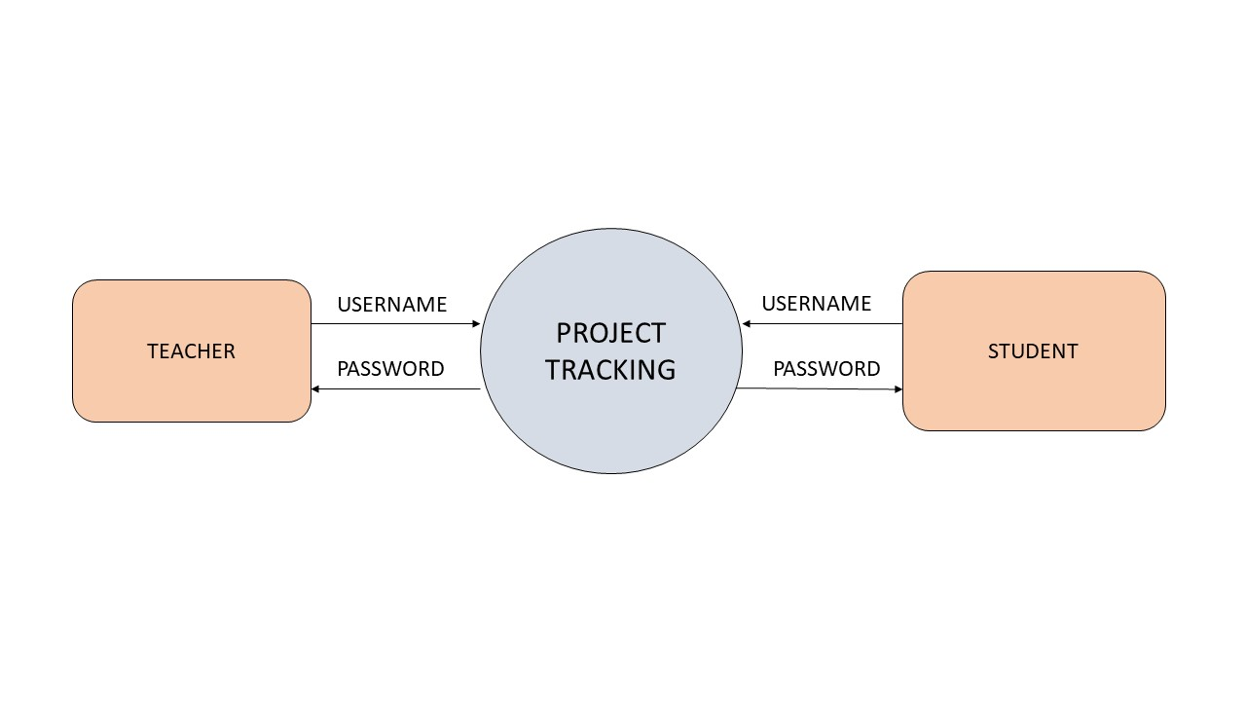
DATA FLOW DIAGRAM
Level 0:

Slide 15
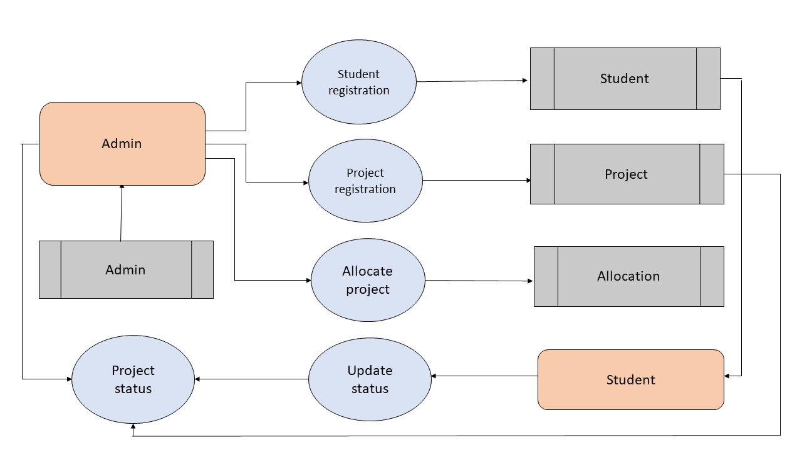
LEVEL 1:

Slide 16
TABLES:
ADMIN TABLE
FIELD NAME | FIELD TYPE | SIZE | CONSRAINT
id | int | 10 | Primary key
username | varchar | 15 | Not null
password | varchar | 15 | Not null

Slide 17
STUDENT TABLE
FIELD NAME | FIELD TYPE | SIZE | CONSTRAINT
id | int | 10 | Primary key
name | varchar | 15 | Not null
rollno | varchar | 15 | Not null
department | varchar | 15 | Not null
classname | varchar | 15 | Not null
guidename | varchar | 15 | Not null
mobile | varchar | 10 | Not null
username | varchar | 15 | Not null
password | varchar | 15 | Not null

Slide 18
PROJECT TABLE
FILED NAME | FIELD TYPE | SIZE | CONSTRAINT
id | int | 10 | Primary key
title | varchar | 30 | Not null
description | varchar | 30 | Not null
modules | varchar | 100 | Not null
technology | varchar | 100 | Not null

Slide 19
ALLOCATE TABLE
FIELD NAME | FIELD TYPE | SIZE | CONSTRAINT
id | int | 10 | Primary key
studentid | int | 10 | Foreign key
projectid | int | 10 | Foreign key
status | varchar | 30 | Not null

Slide 20
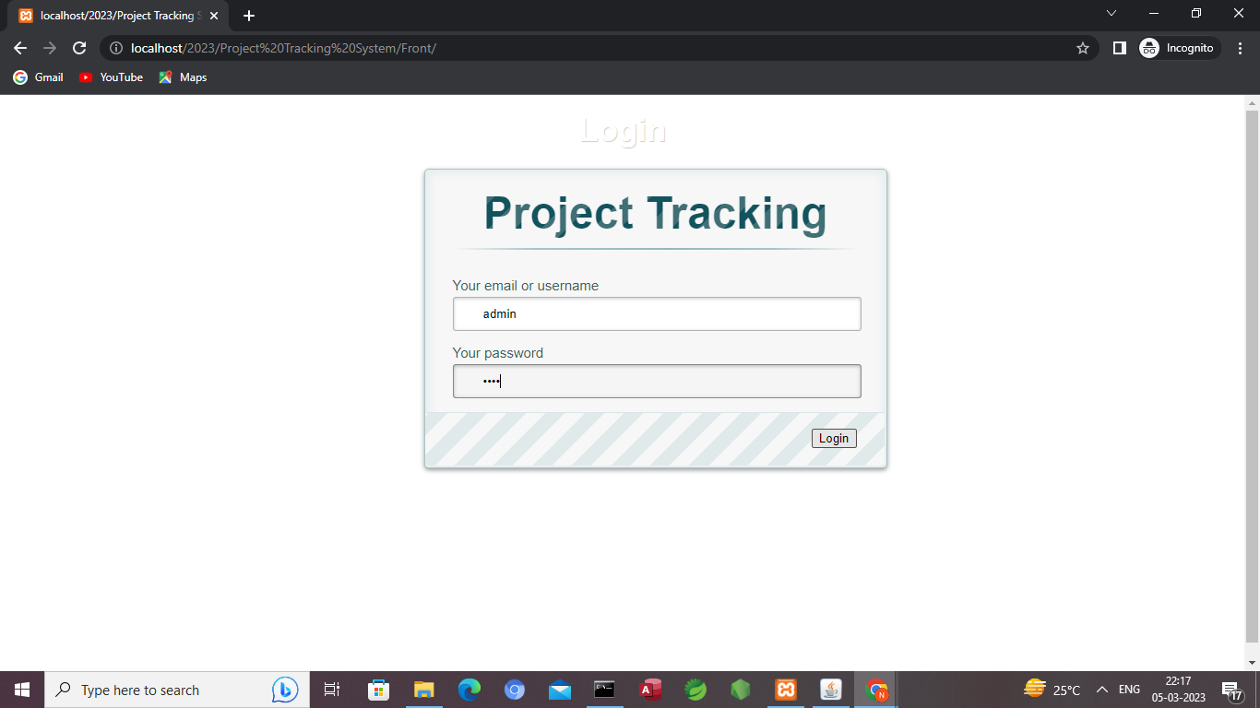
FORM DESIGN

Slide 21
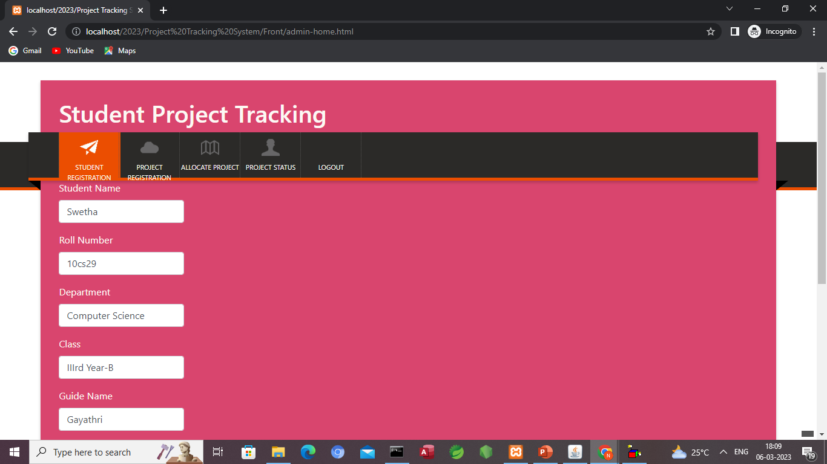
STUDENT REGISTRATION

Slide 22
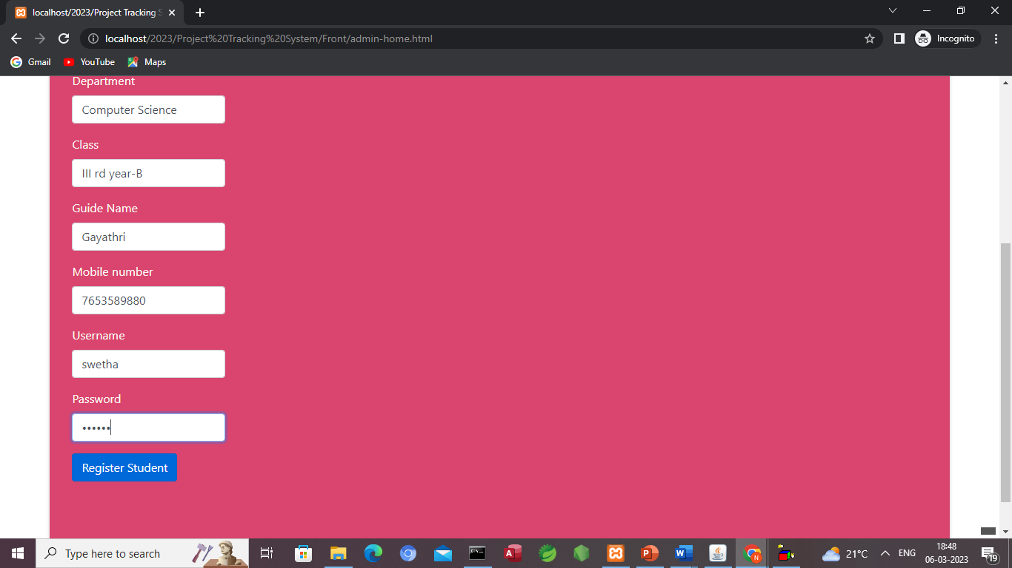

Slide 23
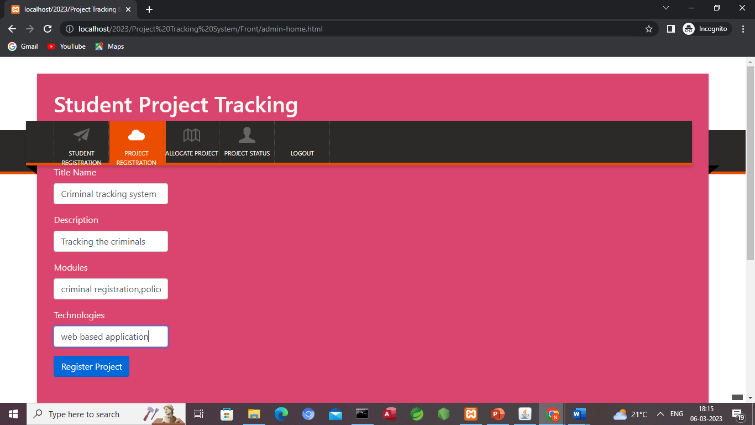
PROJECT REGISTRATION

Slide 24
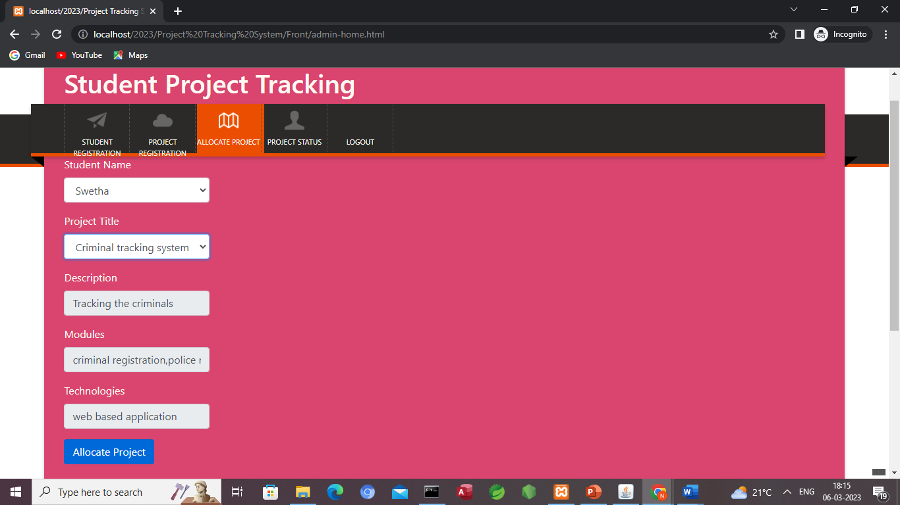
ALLOCATE PROJECT

Slide 25
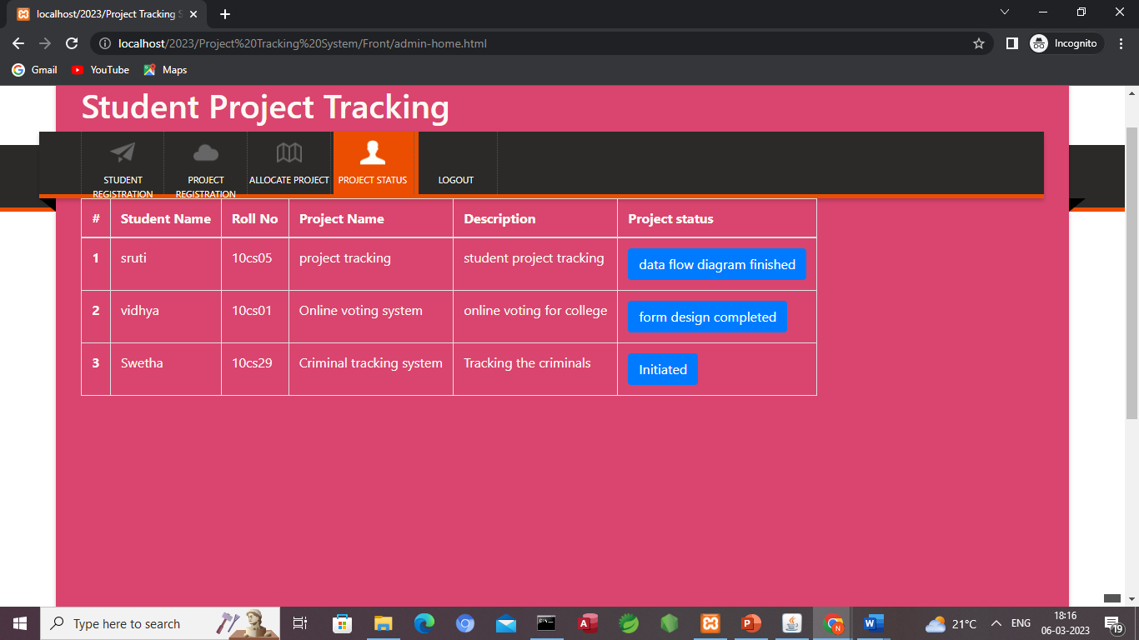
PROJECT STATUS

Slide 26
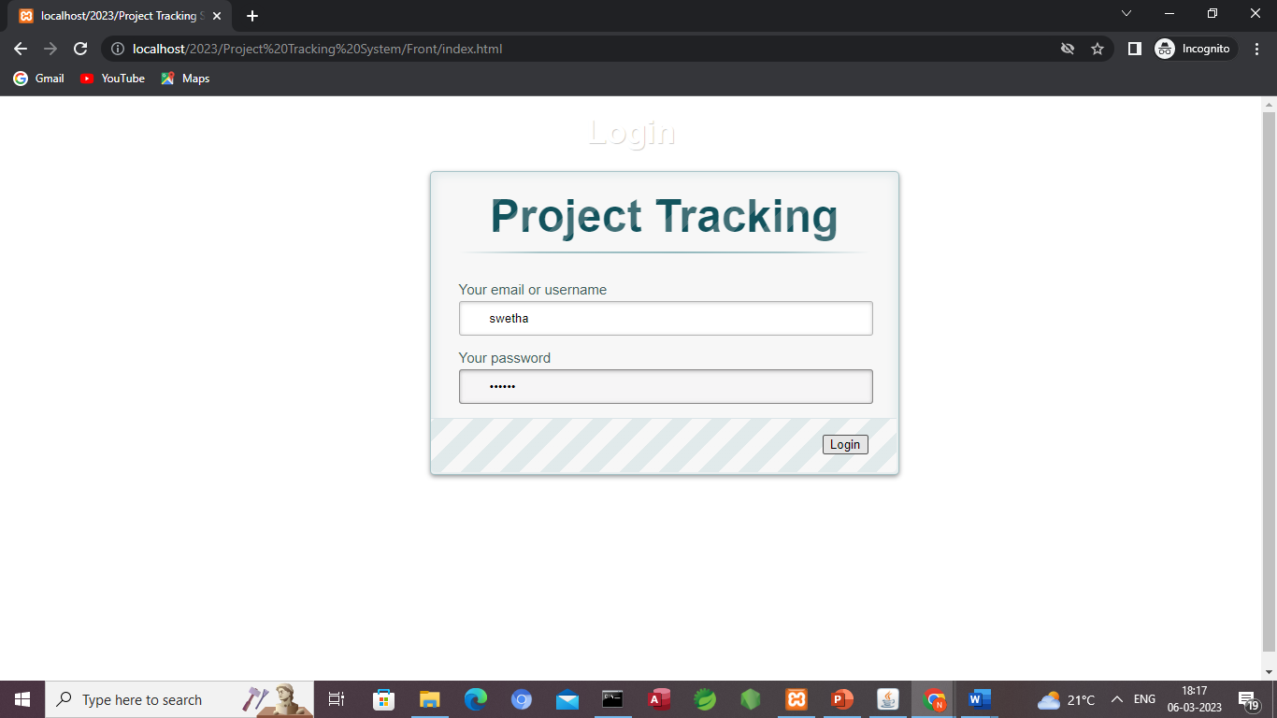
STUDENT LOGIN

Slide 27
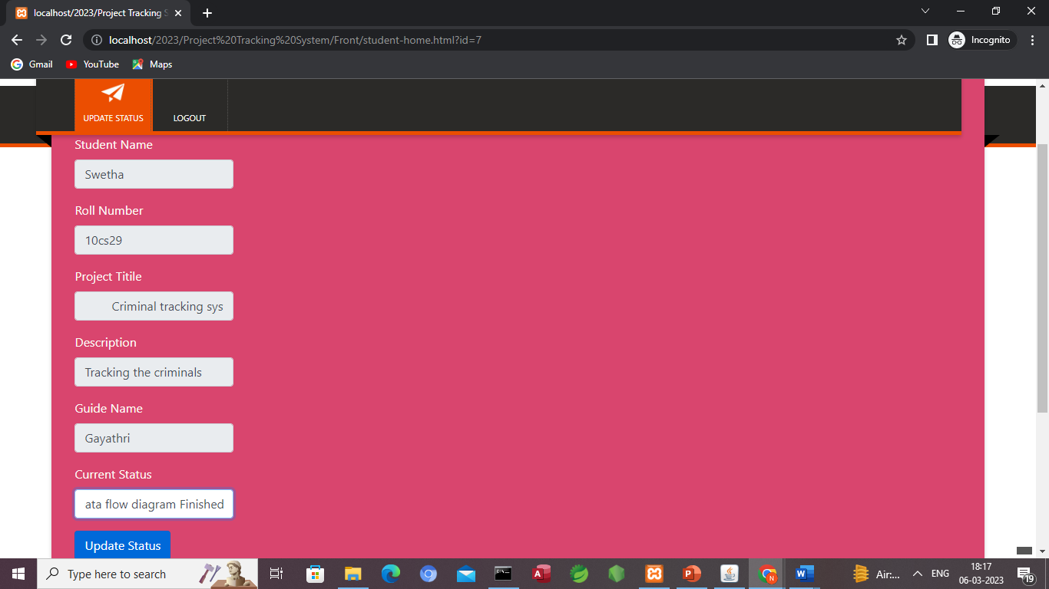
UPDATE STATUS

Slide 28
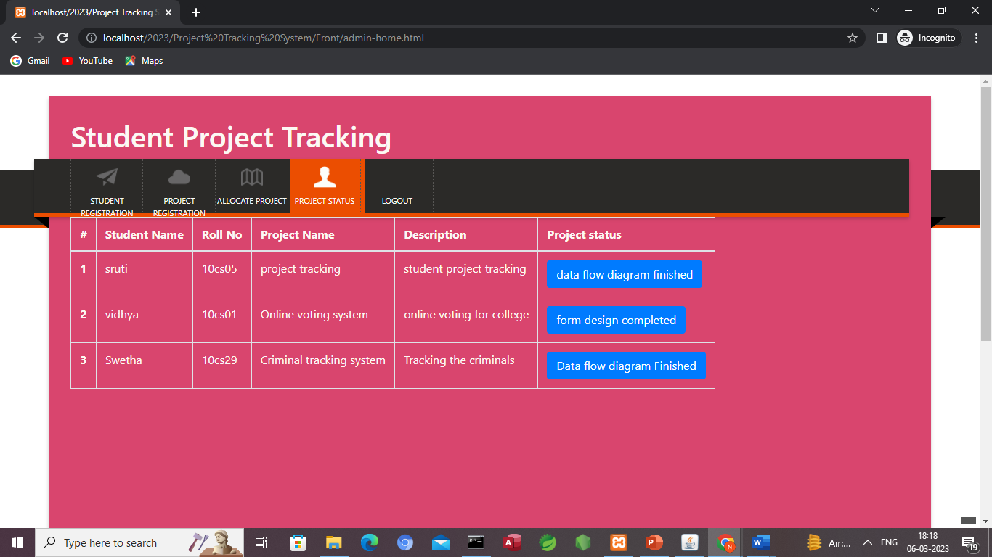
PROJECT STATUS

Slide 29
Thank You

